Slide 1
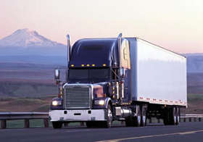

USDOT Numbers
USDOT 123

Slide 2
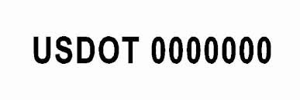
What is a USDOT #?
The USDOT # is the number that the Federal Motor Carrier Safety Administration (FMCSA) assigns to each commercial vehicle that operates in interstate commerce.
Interstate commerce means trade, traffic, or transportation in the United States—
Between a place in a State and a place outside of such State (including a place outside of the United States);
Between two places in a State through another State or a place outside of the United States; or
Between two places in a State as part of trade, traffic, or transportation originating or terminating outside the State or the United States.
The USDOT number must be marked on all of the vehicles.

Slide 3
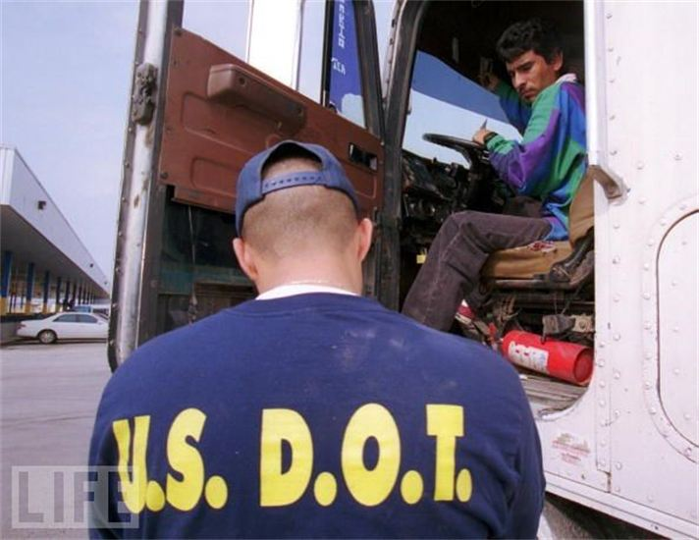
What is the purpose of a USDOT #?
A USDOT number is used by the USDOT as a unique identifier to monitor a company or independent owner-operator’s safety management practices and controls.
This information is acquired during audits, compliance reviews, crash investigations and inspections.

Slide 4
Who needs a USDOT #?
Companies that:
operate commercial vehicles hauling cargo in interstate commerce
are transporting 11 or more passengers, including the driver, in interstate commerce
transport hazardous materials in quantities requiring a safety permit in interstate commerce

Slide 5
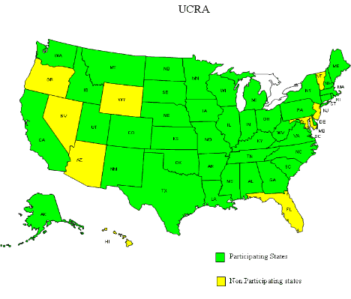
UNIFIED CARRIER REGISTRATION AGREEMENT

Slide 6
What is the UCRA?
The Unified Carrier Registration Agreement is an interstate agreement that is part of a Federally-mandated and State-administered program.
It requires individuals and companies that operate commercial motor vehicles in interstate or international commerce to register their business with a participating state and pay an annual fee based on the size of their fleet.
A "commercial motor vehicle" is defined as a self-propelled vehicle used on the highways in commerce principally to transport passengers or cargo, if the vehicle:
has a gross vehicle weight of 10,001 pounds or more;
is designed to transport 11 or more passengers (including the driver); or
is used in transporting hazardous materials in a quantity requiring placarding.
The revenues generated will be used for enforcement of motor carrier safety programs.

Slide 7
Who is subject to the UCRA?
The UCR Agreement will apply to the following types of operations of passenger and property transportation in interstate commerce:
Motor carrier providing motor vehicle transportation in interstate commerce for compensation;
Motor carriers Motor private carrier (other than a motor carrier) transporting property by motor vehicle when the carrier is the owner or lessee of the property being transported and the property is being transported for sale, lease or rent or to further a commercial enterprise;
Freight forwarder;
Broker; and
Leasing companies

Slide 8
How are UCR Fees Assessed?
Fees are based on the number of commercial motor vehicles owned or operated by the registrant.
The fees charged to a broker, freight forwarder or leasing company is levied at the smallest fee category.
Fleet Size Fee per Company
------------------------------------
0 - 2 $ 76.00
3 - 5 $ 227.00
6 - 20 $ 452.00
21 - 100 $ 1,576.00
101 - 1,000 $ 7,511.00
1,001 - Over $ 73,346.00

Slide 9

Qualified Motor Vehicle?
IFTA vehicle qualified is not necessarily an Apportionable vehicle and vice-versa.

Slide 10
Definition
IRP Plan
IFTA Agreement
―Apportionable Vehicle means (except as provided below) any Power Unit that is used or intended for use in two or more Member Jurisdictions and that is used for the transportation of persons for hire or designed, used, or maintained primarily for the transportation of property, and:
(i) has two Axles and a gross Vehicle weight or registered gross Vehicle weight in excess of 26,000 pounds (11,793.401 kilograms), or
(ii) has three or more Axles, regardless of weight, or
(iii) is used in combination, when the gross Vehicle weight of such combination exceeds 26,000 pounds (11,793.401 kilograms).
Qualified Motor Vehicle means a motor vehicle used, designed, or maintained for transportation of persons or property and:
Having two axles and a gross vehicle weight or registered gross vehicle weight exceeding 26,000 pounds or 11,797 kilograms; or
Having three or more axles regardless of weight; or
Is used in combination, when the weight of such combination exceeds 26,000 pounds or 11,797 kilograms gross vehicle or registered gross vehicle weight.

Slide 11
Recreational Vehicle
IRP Plan
IFTA Agreement
A Recreational Vehicle, a Vehicle displaying Restricted Plates, a bus used in the transportation of chartered parties or a government-owned Vehicle, is not an Apportionable Vehicle; except that a Truck or Truck Tractor, or the Power Unit in a Combination of Vehicles having a gross Vehicle weight of 26,000 pounds (11,793.401 kilograms), or less, and a bus used in the transportation of chartered parties, nevertheless may be registered under the Plan at the option of the Registrant.
Recreational Vehicle means vehicles such as motor homes, pickup trucks with attached campers, and buses when used exclusively for personal pleasure by an individual. In order to qualify as a recreational vehicle, the vehicle shall not be used in connection with any business endeavor.

Slide 12
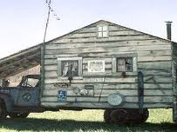

Recreations Vehicle, do I report miles on this?

Slide 13
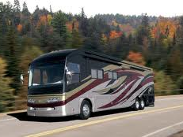

Portia’s new motorhome, can she apportion it?
Do I need to have an IFTA license?

Slide 14
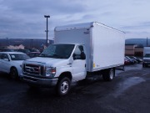
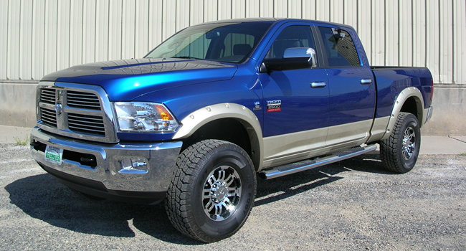
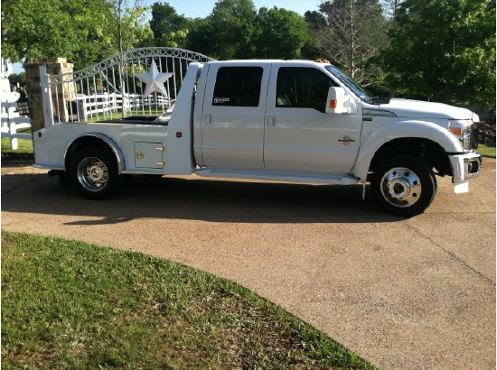
IRP Plan Official Commentary
A Vehicle is determined to be apportionable according to the characteristics and use of the Vehicle or the Combination of Vehicles.……….
Certain types of vehicles or Combinations of Vehicles that travel or are intended to travel in two or more Member Jurisdictions, but are not otherwise within the definition of Apportionable Vehicle may be apportioned if the Registrant so chooses……………

Slide 15
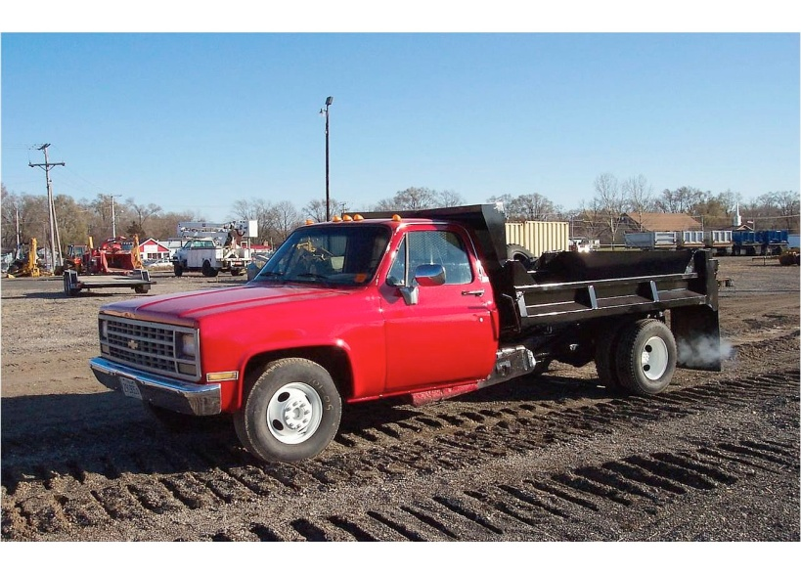
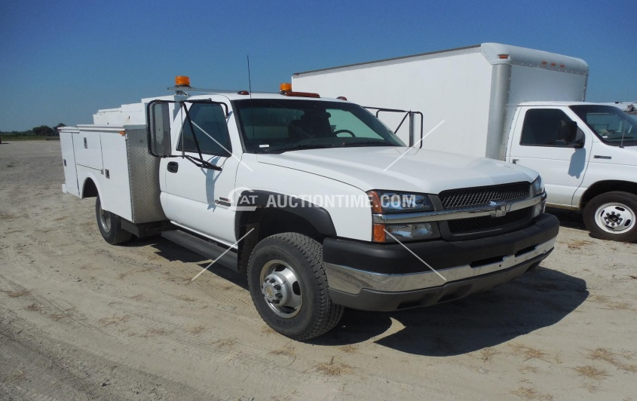
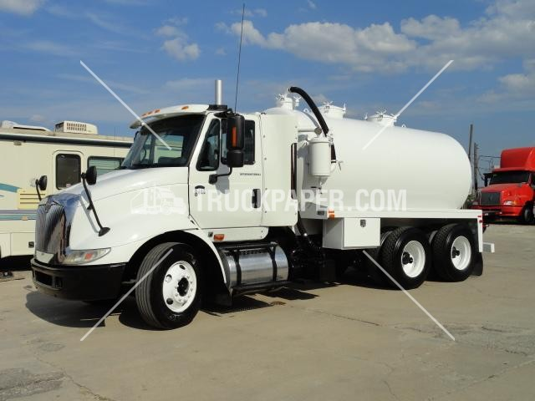
Can all of these vehicles be registered and licensed in both IFTA & IRP?

Slide 16
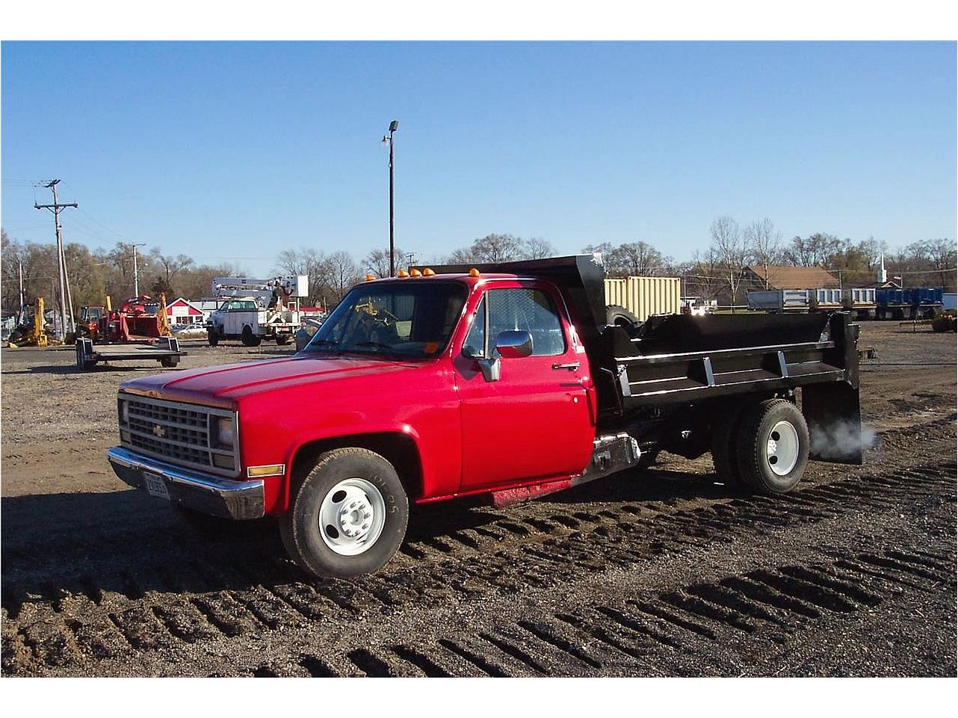
1989 Chevrolet C3500
IRP?
IFTA?
GVWR 10,000 lbs or less

Slide 17
2001 International 4900 4X2 Conv
26,001 or more lbs
IRP?
IFTA?

Slide 18
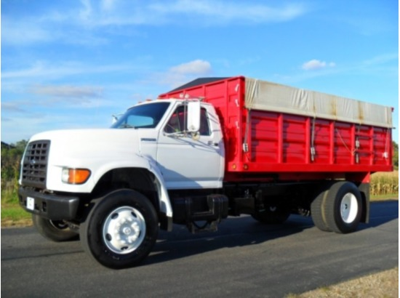
Would this vehicle have to be registered as an IRP unit?
Would this vehicle have to have an IFTA license?

