Slide 1
Arizona Department of Transportation
IFTA
RECORD KEEPING REQUIRMENTS
Notes:
Add truck sound in background

Slide 2
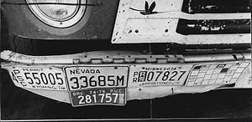
Brief History of IFTA/IRP
Pre-IFTA/IRP:
  Carriers filed use-fuel tax returns to every jurisdiction in which operated
  Registration maintained in separate jurisdictions
With IFTA/IRP:
  Carriers file one use-fuel tax return to base jurisdiction w/info for all jurisdictions in which traveled
  Registration apportioned to jurisdictions based on travel & maintained by base jurisdiction

Slide 3
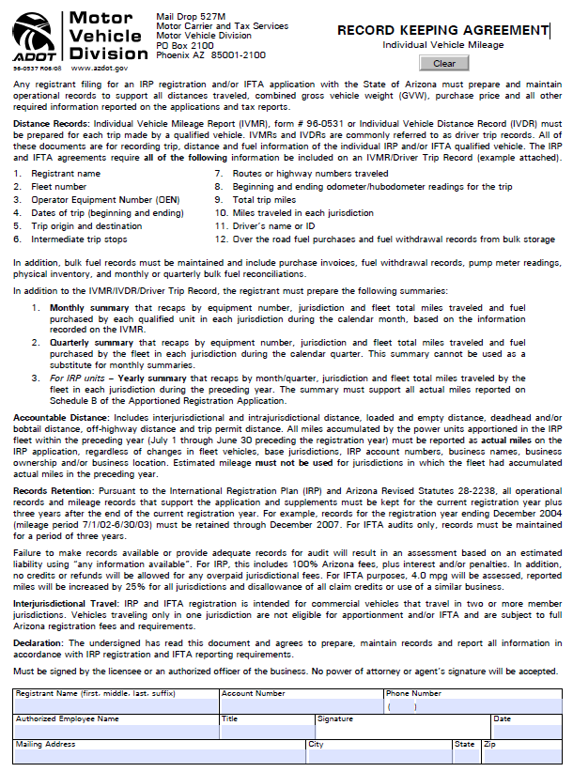
Notes:
This is a Record Keeping Agreement (RKA). It is required to be signed every year by the owner of the IFTA account before IFTA decals are issued.
It details the records required to document trips for IFTA & subsequently IRP purposes.
The individual requirements of the RKA will be discussed in detail in the presentation.
The Attorney General uses signed RKAs as proof a taxpayer is required to keep the documentation detailed within the agreement for 4 years.
Revenue Audit uses this document to show the taxpayer the consequences of not maintaining the required documentation.

Slide 4
The 3 Main Recordkeeping Requirements
Summaries
Fuel Invoices
Individual Vehicle Mileage Records (IVMRs)
Notes:
What records are required?
IVMRs – Fuel Invoices – Summaries
Let’s discuss what is required for IVMR documentation.

Slide 5
IVMR Requirements
Company Name
Vehicle Number
Driver Name
Date of Trip
Beginning Odometer
Starting City (Origin)
Intermediate Stops
Routes/Highway #s
Odometer Readings at State Lines
Miles by State
Ending City (Destination)
Ending Odometer
Total Trip Miles
Fuel Purchases by State
Notes:
It’s a lot of information.

Slide 6
Things to think about when verifying accuracy
Beginning and ending odometers
MPG test- high or low
Missing states?
Be Aware – look at the quarterly return to verify

Slide 7
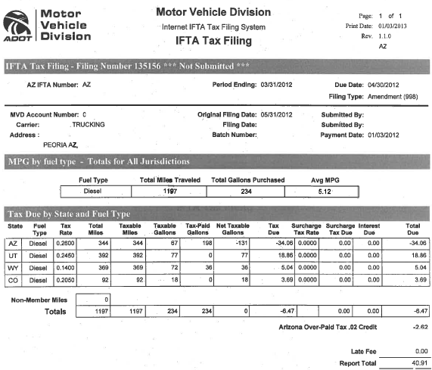
Ideal IFTA Report

Slide 8
IVMR Ideal Example
ABC Trucking
A. Trucker
4/12/12
13
123,456
4/12
Phoenix
123,456
I17, US89, US89A
123,800
AZ
344
Love’s
Phoenix
AZ
198
4/13
123,800
US89, I15, I80
124,192
UT
392
4/13
124,192
I80, I25
124,561
WY
369
Cheyenne
Flying J
WY
36
4/14
Denver
124,561
I25
124,653
CO
92
124,653
234
1,197
1,197
5.12
Notes:
Here’s an ideal example.
Company Name
Vehicle Number
Driver Name
Date of Trip
Beginning Odometer
Starting City (Origin)
Intermediate Stops
Routes/Highway #s
Odometer Readings at State Lines
Miles by State
Ending City (Destination)
Ending Odometer
Total Trip Miles
Fuel Purchases
Total Fuel
MPG Test – to help verify fuel purchases

Slide 9
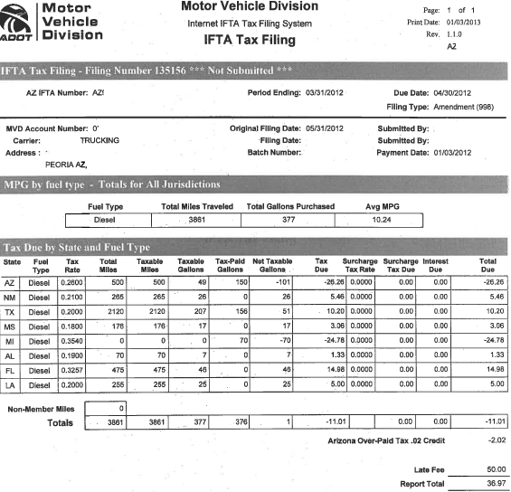
Questionable IFTA Report

Slide 10
IVMR Not-So Ideal Example
ABC Trucking
A. Trucker
4/12/12
13
100,500
4/12
Phoenix
100,500
I-10
100,750
AZ
250
Pilot
Eloy
AZ
150
4/13
100,750
I-10
100,850
NM
100
4/14
100,850
I-10
102,070
TX
1220
4/14
102,070
I-10
102,158
MS
88
Flying J
Gulfport
MI
71
4/15
102,158
I-10
102,228
AL
70
4/15
Orlando
102,228
I-10, I-75
102,703
FL
475
Return trip below
4/20
Gulfport
103,160
I-10
103,248
MS
88
4/20
103,248
I-10
103,503
LA
255
4/21
103,503
I-10
104,403
TX
900
Love’s
Junction
TX
156
4/22
104,403
I-10
104,568
NM
165
4/22
Phoenix
104,568
I-10
104,818
AZ
250
104,818
377
4,318
3,861
10.25
Notes:
What’s wrong?
1 – NM miles short
2 – missing state
3 – gap miles & missing states for empty/unloaded section – return trip start does not match previous trip end destination – return trip odometer does not match previous trip odometer
4 – total trip miles do not match total odometer miles
5 – wrong state for fuel
6 – MPG test – indicates missing fuel invoices
MPG test 3861 miles/377 gal = 10.25
MPG test 4318 miles/377 gal = 11.45

Slide 11
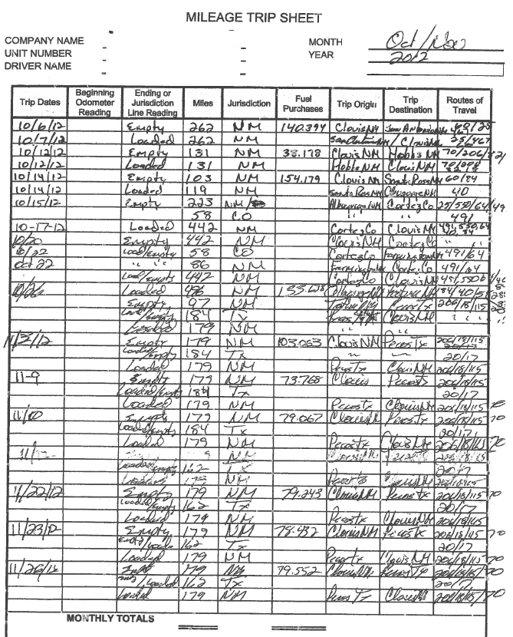

Slide 12
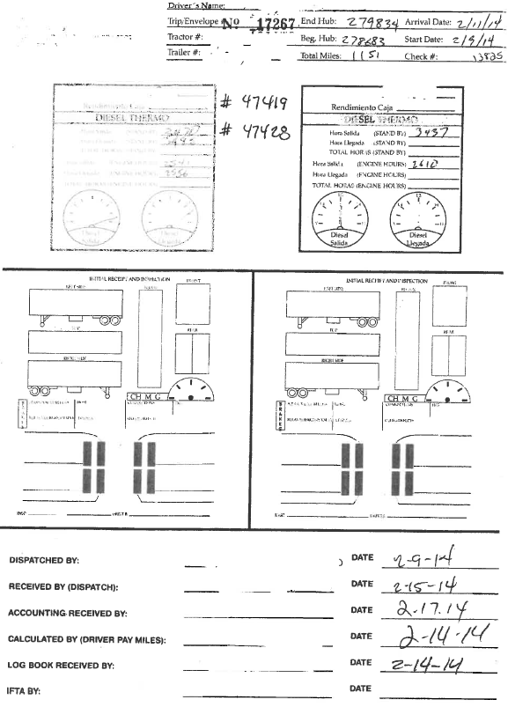

Slide 13
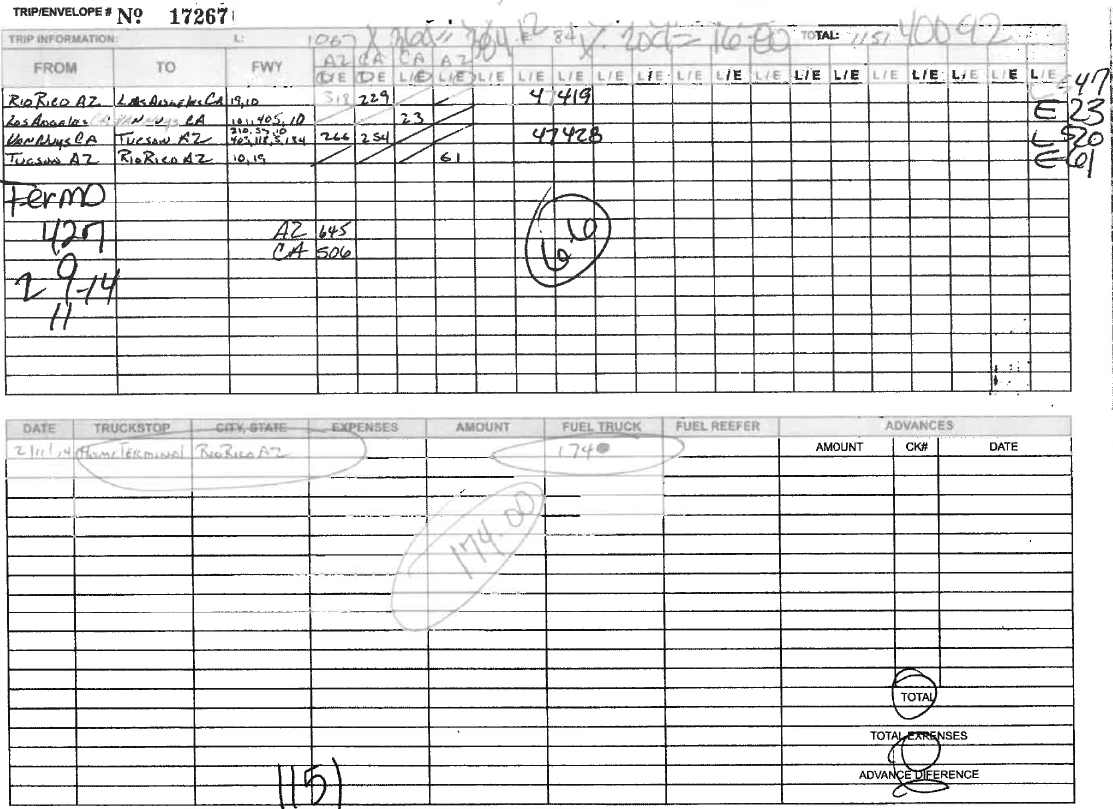

Slide 14
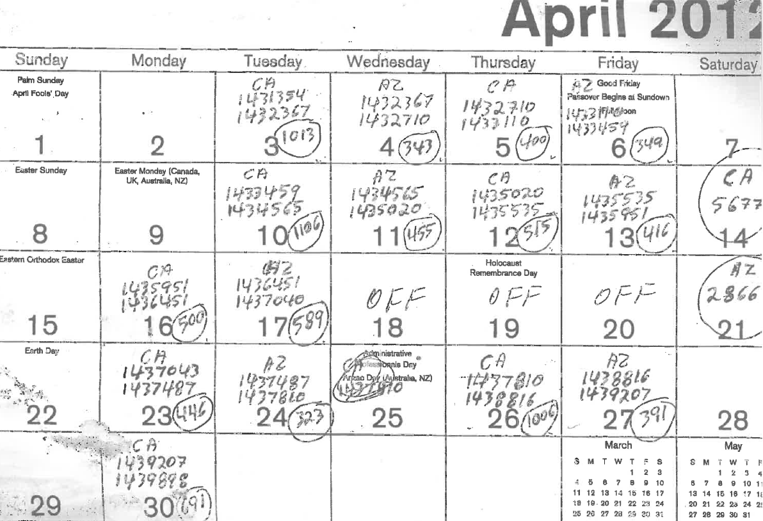

Slide 15
The 3 main Recordkeeping Requirements
Summaries
Fuel Invoices
Individual Vehicle Mileage Records
Notes:
Make the top and bottom levels disappear, fuel invoices is gonna get bigger

Slide 16
Fueling Options
At the pump
Cardlock
Bulk Fuel

Slide 17
Fuel Invoice Requirements
Company Name
Vehicle Number
Date of Purchase
Station Location
Location State
Pump Number
Fuel Type
Reefer (Y/N)
  Reefer – non-taxable
Quantity (gallons)
Price per Gallon
Tax Rate (AZ only)
Notes:
It’s a lot of information.

Slide 18
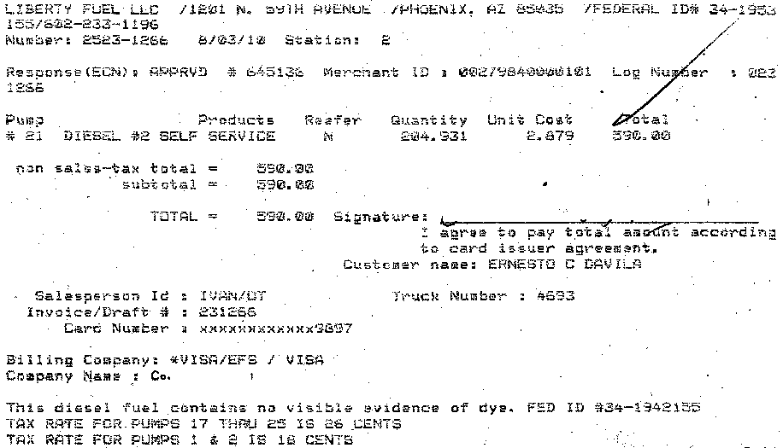
Fuel Receipts: The Good…

Slide 19
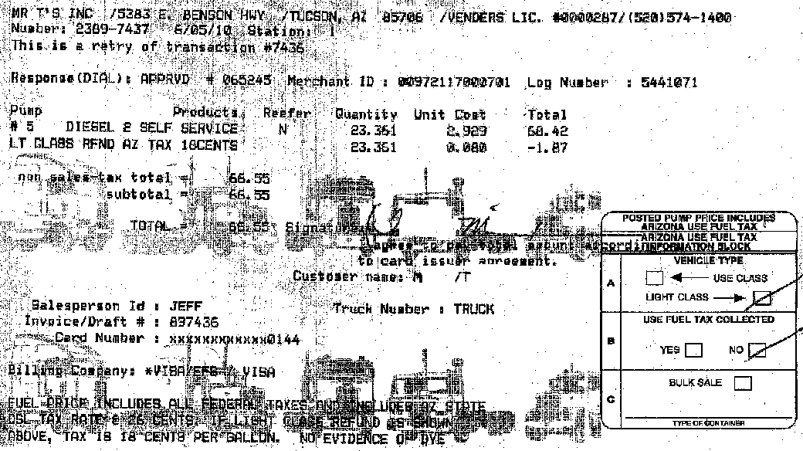
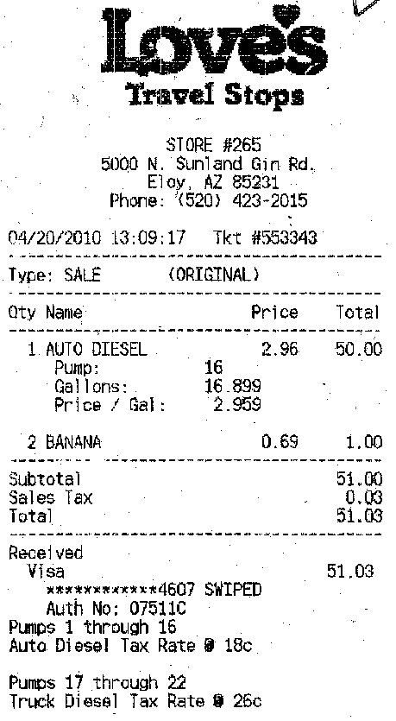
Fuel Receipts: The Bad…

Slide 20
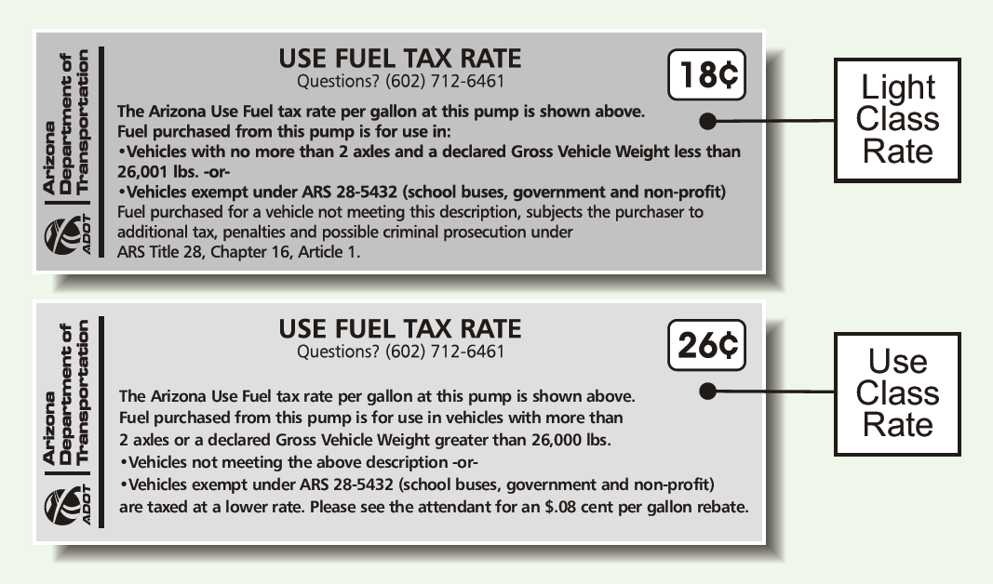
Verifying the Tax Rate

Slide 21
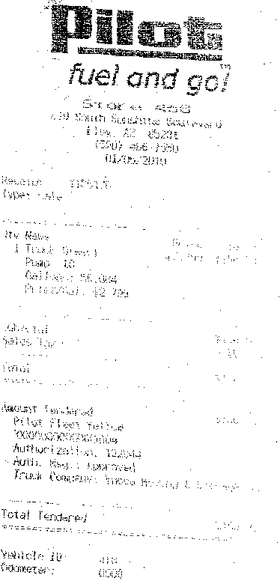
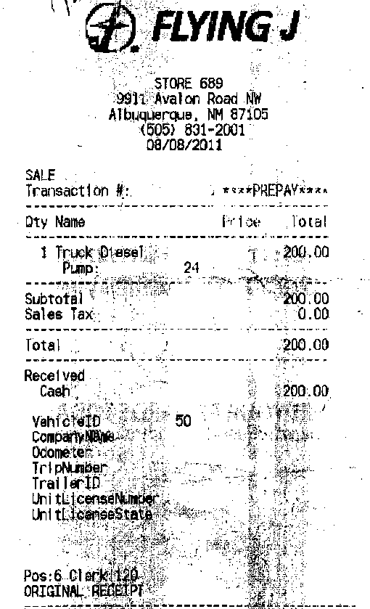
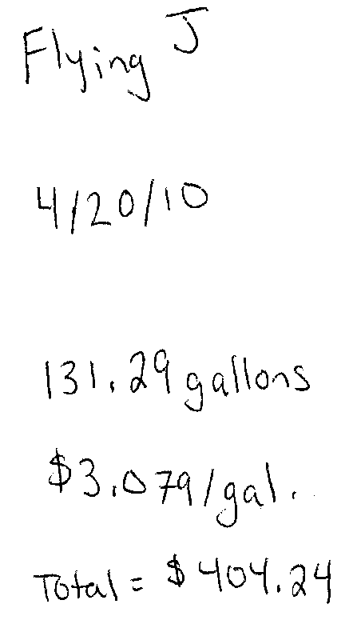
Fuel Receipts: & The Ugly
Unreadable!
Pre-Paid & No per gallon amount
Hand Written!

Slide 22
Other Fueling Options
Cardlock: verify the tax rate.
Bulk Fuel:
  Verify the tax rate.
  Keep all delivery receipts.
  Keep a fueling log.
  Keep pump meter readings.
  Balance your fuel inventory regularly.

Slide 23
The 3 main Recordkeeping Requirements
Summaries
Fuel Invoices
Individual Vehicle Mileage Records
Notes:
Make the top and bottom levels disappear, fuel invoices is gonna get bigger

Slide 24
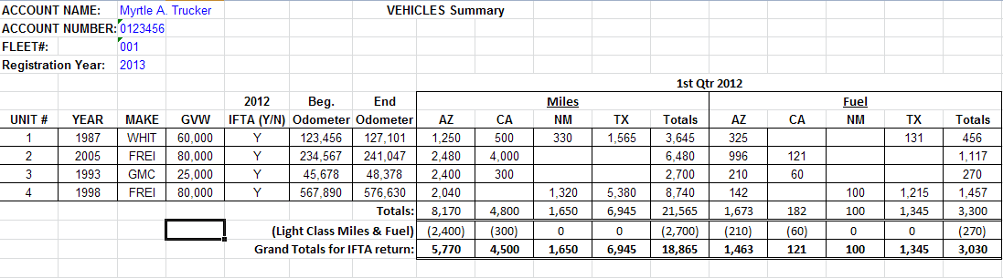
Summaries

Slide 25
Why should I keep these records?
It’s required under IFTA, IRP, and by Arizona!
Without the required records ADOT auditors will not be able to determine if you have paid the right amount of tax. If an auditor finds that your records are missing or incomplete, you could be setting yourself up for a Best Information Available (BIA) assessment.
IFTA Audit Manual Section A540.200, “The audit will be completed using the best information available to the base jurisdiction. The burden of proof is on the licensee.”

Slide 26
What happens in a BIA Audit?
For IFTA BIA assessment, we will estimate your operations as follows:
  Miles – increase reported miles by 25%
  Fuel consumption based on a 4.0 mpg
  No credit allowed for fuel purchases

Slide 27
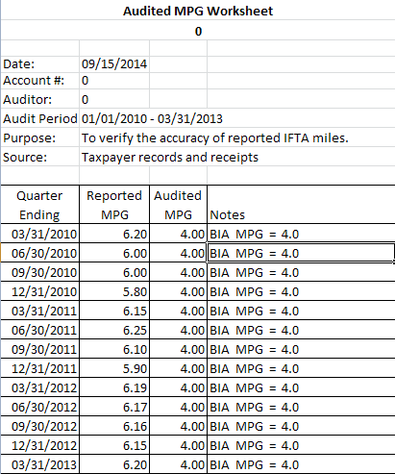
Change MPG to 4.0
For two jurisdictions (AZ and CA) the assessment becomes:
$18,886.12

Slide 28
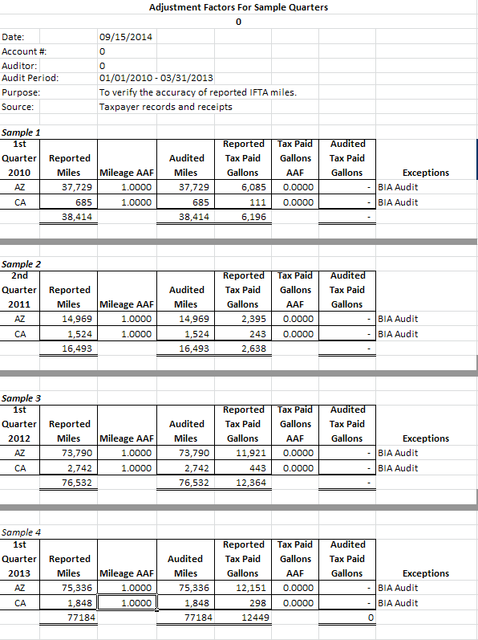
Change MPG to 4.0 & Disallow Tax-Paid Gallons
For two jurisdictions (AZ and CA) the assessment becomes:
$52,362.12

Slide 29
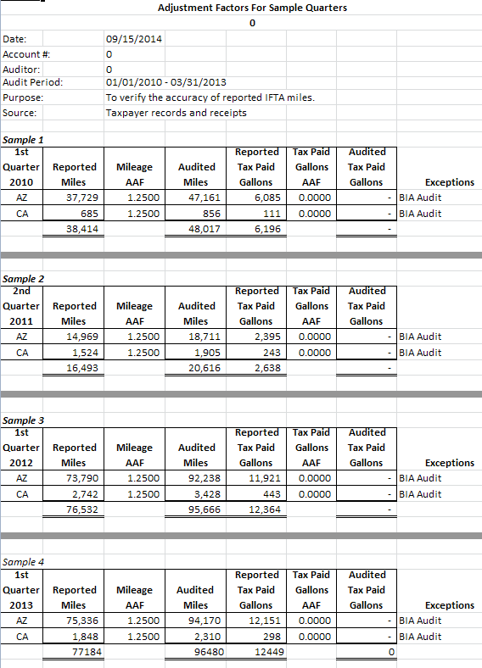
Full BIA: Drop MPG, disallow tax-paid gallons, increase miles
For two jurisdictions (AZ and CA) the assessment becomes:
$70,687.70

Slide 30
Miscellaneous Records
Maintenance Records
DOT Logs – Do NOT discard! – keep for 3-4 years
Bills of Lading
Payroll records/Settlement Statements
Fuel Card Statements
Customer Invoices

Slide 31
Maintenance Records
APRIL 2010 TRACTOR REPORT
UNIT | DATE | MILEAGE | REPAIR
95
 | 09-Apr | 641153 | SHORT SERVICE - GREASE, CHK TRANNY & DIFFS, STEER HUB
 |  |  | OIL, U-JOINTS, WATER HOSES, IDLER PULLEYS
 |  |  | TOP FRONT DIFF OFF WITH OIL…LOOK FOR LEAK
JUNE 2010 TRACTOR REPORT
UNIT | DATE | MILEAGE | REPAIR
95
 | 30-Jun | 675459 | FIND OUT A/C COMPRESSOR BAD…PARK BY FENCE…REMOVED
 |  |  | AIR COMP. STEEL HOSE READY FOR 103

Slide 32
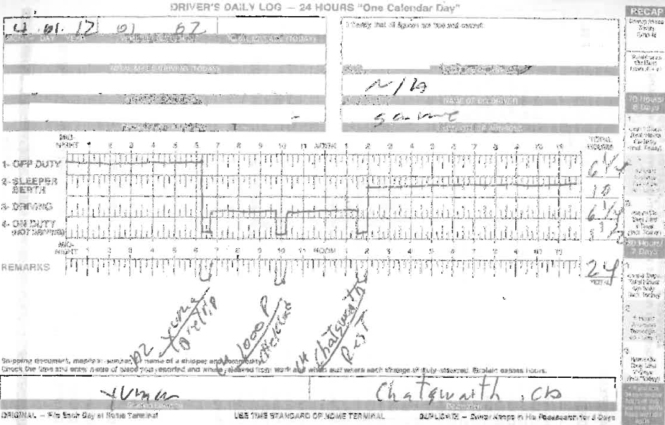
US DOT Driver’s Logs

Slide 33
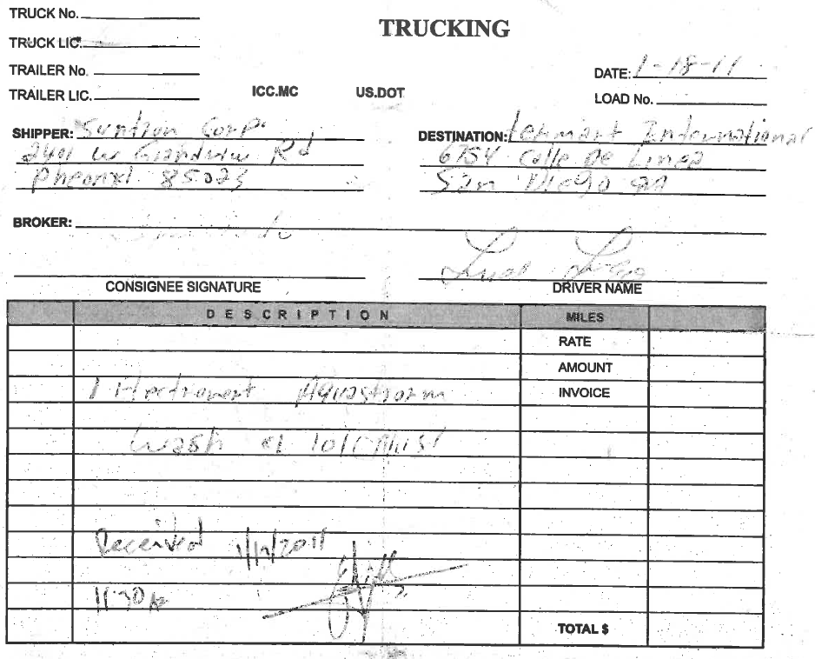
Bills of Lading

Slide 34
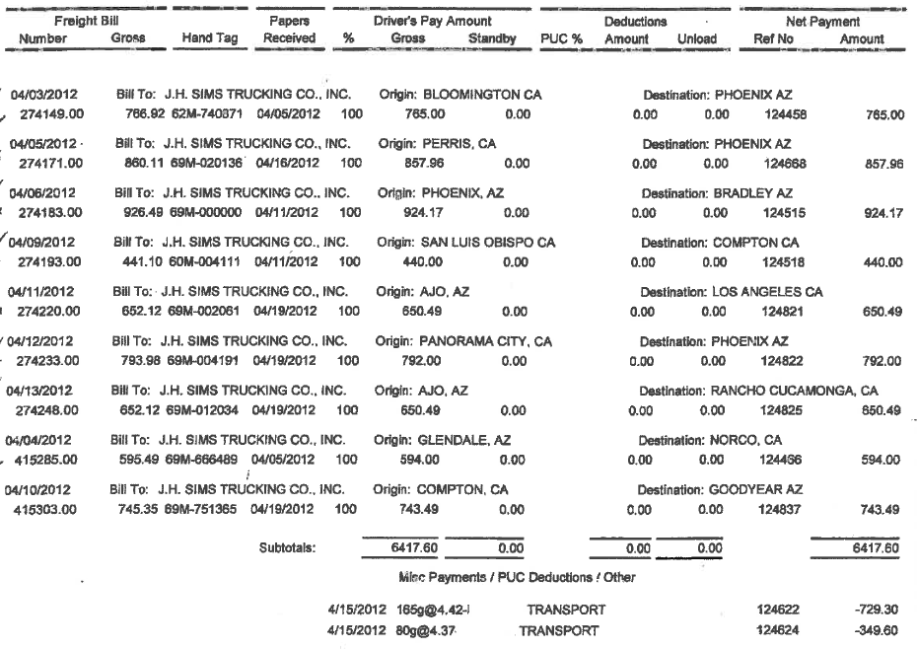
Payroll Records/Settlement Statements

Slide 35
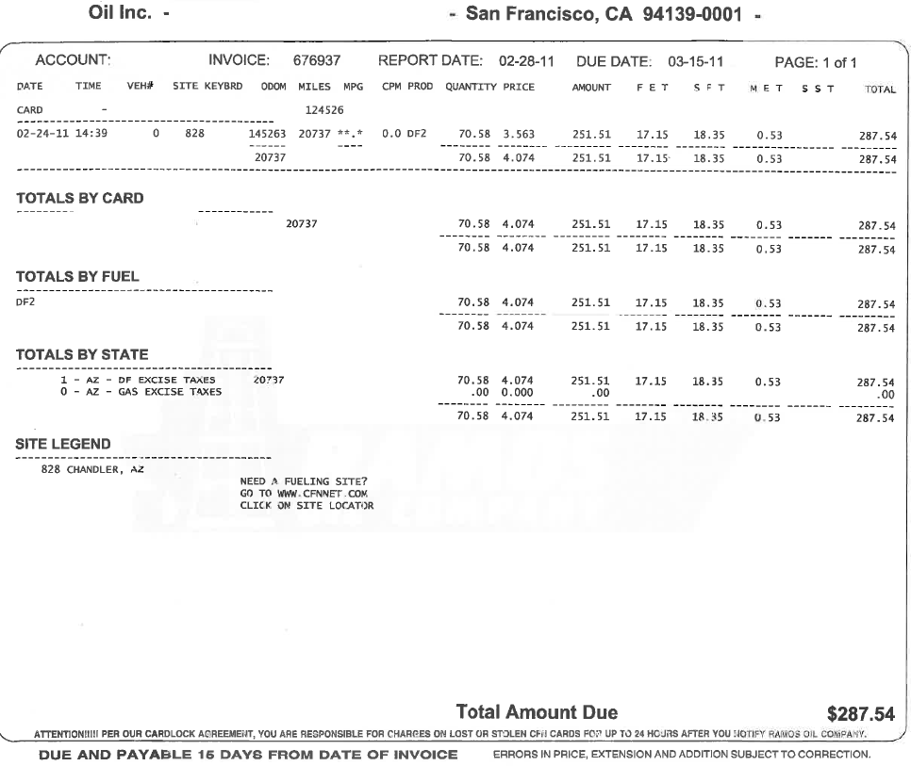
Fuel Card Statements

Slide 36
Miscellaneous Records
Method of tracking IFTA decals to vehicles
  Great for fleets of > 1 vehicle
Power of Attorney (POA)
  For fuel tax agents
  Attorneys
  Other company representatives
Lease agreements for vehicles that you lease or that are leased to you
  Who has ultimate responsibility for IFTA returns

Slide 37
Off-Road Miles & Fuel
Roads NOT maintained by govt. entity
  Private roads
    Farms
    Mines
Must maintain detailed records for off-road credit!

Slide 38
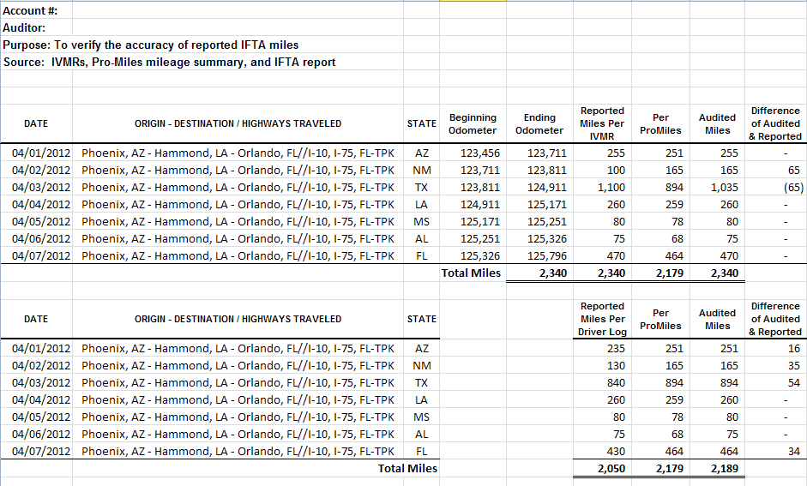
Auditing IFTA Records

Slide 39
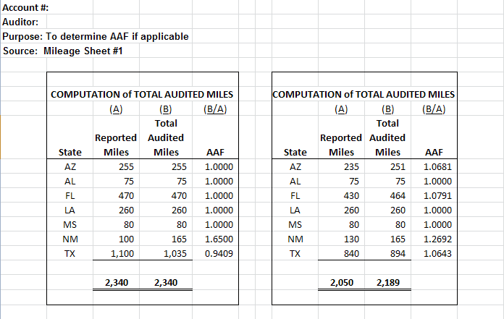
Auditing IFTA Records
Allocation with Odometer Readings
Application of Miles w/o Odometer Readings

Slide 40
Auditing IFTA Records
Now for some examples…

Slide 41
Contact Information
Motor Carrier Licensing Unit
Phone: (602) 712-8912
Fuel Tax Reporting
Phone: (602) 712-8473
Revenue Audit
Phone: (602) 712-8300
Fuel Tax Evasion
Hotline: 877-AZFUELS
877-293-8357
1801 W. Jefferson St.
Phoenix, AZ 85007
IFTA Website: http://www.iftach.org/
IRP Website: http://www.irponline.org
ADOT Website: http://www.azdot.gov/mvd/motorcarrier/ifta.asp

