Slide 1
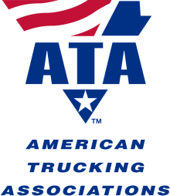
Alternative Fuels:
An Update

Slide 2
TOPICS
Natural Gas for Heavy-Duty Trucks
  Pros and Cons
  Current Use of N/G
  Future Scope
Considerations for Government
  Incentives
  Tax Administration
DME

Slide 3
Deciding on N/G
Greenness
Fuel Supply & Availability
Equipment
  Cost
  Weight
  Efficiency
  Maintenance
  Durability

Slide 4
It’s the Costs
It’s All a Balance:
CNG Costs $1.50 Less per Gallon than Diesel
LNG Costs $1.00 Less per Gallon than Diesel
The Price Differentials Will Grow Over Time
Fuel Makes Up c. 40% of Operating Costs
N/G Trucks May Cost More, Weigh More, and Be Less Efficient, and Still Come Out Ahead

Slide 5
Current Use of N/G
Transit
Waste Hauling
California
Lots of Experimentation
  P&D
  Long-Haul

Slide 6
Future Scope
Predictions Vary Widely
EIA: N/G Share of Transp’n Fuel Still Low a Decade From Now
Perhaps 6-8% of New Class 8s by 2016
  Mostly Transit Buses, Garbage Trucks
  But Some Over-the-Road Interstate Tractors

Slide 7
Incentives
Tax Rates
Purchase of Rolling Stock
Fueling Facilities
Requirements for Government Use
Miscellaneous

Slide 8
Tax Administration
Tax Rate
Tax Structure
Tax Incidence
Fuel Deliveries
Refunds
Audit & Enforcement
IFTA Reporting

Slide 9
DME
Dimethyl Ether – The Fuel of the Future ?
Availability
Equipment
Costs
Taxation

