Slide 1
AUDITING 101
Presented by:
Kelly Heaton – AR
Michaela Van Dyke - NV

Slide 2
What we’ll cover today
Acronyms
Keeping the Main Thing the Main Thing
Questions from YOU!
Record Requirements
Audit Process
Q&A discussion

Slide 3
Acronyms
AAMVA - American Association of Motor Vehicle Administrators
ATA - American Trucking Associations
CCMTA - Canadian Council of Motor Transport Administrators
CDL - Commercial Driver's License
CMV - Commercial Motor Vehicle
CNG - Compressed Natural Gas
DOT - Department of Transportation
ELD - Electronic Logging Device

Slide 4
Acronyms (cont’d)
EOBR - Electronic On-Board Recorder
ECM - Engine Control Mechanism
FHWA - Federal Highway Administration
FMCSA - Federal Motor Carrier Safety Admin.
GPS - Global Positioning System
GVW - Gross Vehicle Weight
HAZMAT - Hazardous Material
HOS - Hours-Of-Service
HVUT - Heavy Vehicle Use Tax

Slide 5
Acronyms (cont’d)
IVDR - Individual Vehicle Distance Record
KPL - Kilometers per Liter
LNG - Liquified Natural Gas
LPR - License Plate Reader
MPG - Miles per Gallon
NTSB - National Transportation Safety Board
SAFER - Safety and Fitness Electronic Records System

Slide 6
Acronyms (cont’d)
UCR - Unified Carrier Registration
USDOT - United States Department of Transportation
VIN - Vehicle Identification Number
WIM - Weigh-in-Motion

Slide 7
The MAIN THING
Total Distance
Total Fuel
Jurisdiction Distance
Jurisdiction Fuel
MPG/KPL

Slide 8
Total Distance
Why is this important?
We cannot determine an accurate MPG/KPL without an accurate total distance.
How do we determine Total Distance?
What are some issues we have in trying to determine Total Distance?

Slide 9
Record Keeping Requirements – Distance (P540; Plan 1010)
Manual System –
Beginning / ending trip dates
Trip origin / destination
Route of travel
Beginning / ending odometer reading (hub, engine control module [ECM], or similar device)
Total trip distance
Distance per jurisdiction
Vehicle identifier

Slide 10
Record Keeping Requirements - Distance
Electronic – Global Positioning System (GPS):
Original GPS or other location data for the vehicle
Date & time of each GPS or other system reading
Location of each GPS or other system reading
Beginning / ending reading (odometer, hub, engine control module [ECM], or similar device)
Calculated distance between each GPS reading
Routes of travel
Total distance and distance per jurisdiction
Vehicle identifier

Slide 11
Total Fuel
Why is this important?
We cannot determine an accurate MPG/KPL without an accurate total fuel.
How do we determine Total Fuel?
What are some issues we have in trying to determine Total Fuel?

Slide 12
Jurisdiction Distance
Why is this important?
We cannot properly allocate fuel tax revenue without knowing the total distance traveled within each jurisdiction.
How do we determine Jurisdiction Distance?
What are some issues we have in trying to determine Jurisdiction Distance?

Slide 13
Jurisdiction Fuel
Why is this important?
We cannot give appropriate tax paid credit without knowing the total fuel purchased within each jurisdiction.
How do we determine Jurisdiction Fuel?
What are some issues we have in trying to determine Jurisdiction Fuel?

Slide 14
Record Keeping Requirements – Fuel (P550)
Receipts, invoices, vendor transaction listings with:
Date
Vendor’s name/location (properly identified code)
Quantity purchased
Type of fuel
Price per gallon OR total purchase price
Vehicle
Purchaser’s name

Slide 15
Record Keeping Requirements - Fuel
Bulk Tanks:
Delivery receipts, including proof of tax paid
Quarterly inventory reconciliations
Tank capacity
Withdrawal records
Location facility
Date
Quantity
Type
Vehicle

Slide 16
MPG/KPL
Why is this important?
We cannot accurately calculate the “total gallons required” or another way to say it is “total tax/credit due for each jurisdiction” without an accurate MPG/KPL.

Slide 17
MPG/KPL
How do we determine MPG/KPL?
Total Distance / Total Fuel = MPG/KPL
What are some issues we have in trying to determine MPG/KPL?

Slide 18
MPG/KPL
MPG/KPL is directly correlated to Distance.
Distance goes Up – MPG/KPL goes UP
Distance goes Down – MPG/KPL goes Down

Slide 19
MPG/KPL
MPG/KPL is opposite of Fuel
Fuel goes UP – MPG/KPL goes DOWN
Fuel goes Down – MPG/KPL goes Up

Slide 20
The MAIN THING
Total Distance
Total Fuel
Jurisdiction Distance
Jurisdiction Fuel
MPG/KPL

Slide 21
Questions
“Here are some ideas I think would be great if discussed:
Process of an audit
Timeline of an audit”

Slide 22
Questions
Distance software recommendations to achieve the most accuracy.
Determining when it is appropriate to sample and understanding why we would not sample

Slide 23
Questions
“Do auditors have the tools to read “source data”? If so, what formats of source data are usable?”
“If source data is in a file format inaccessible to an auditor, what content in a printed report is minimum? Truck#, date exiting every state, state, odometer reading, distance, location description, source of data, etc.”

Slide 24
Questions
“What outside, secondary sources of Information are helpful/required? e.g. outside fuel vendor reports, dispatch reports, maintenance records, fuel receipts, etc.”
“What would render outside source data inadequate for audit?”

Slide 25
Questions
A company has an IFTA qualified vehicle that is not registered with IRP, has a farm/natural resource tag, AND an IFTA sticker. They also purchased a fuel trip permit for each trip out of base jurisdiction.
Is this company responsible for reporting all jurisdictional miles on their IFTA return?

Slide 26
Questions
“I would be interested in a conversation pertaining to how audits are selected for other states, is it random or not?”

Slide 27
The Audit Process
Preliminary Review
Opening Conference
Internal Control Evaluation
Field Work/Sampling/Testing
Audit Report and Audit File
Closing Conference

Slide 28

Preliminary Review
Preparations
IFTA/IRP requirements (A310/APM501)
Review reported data and company’s record process
Equipment information
Analytical review
- Questionnaire

Slide 29

Audit Notification
IFTA Audit Manual A420
IRP Audit Manual APM401

Slide 30
The Audit Process
Preliminary Review
Opening Conference
Internal Control Evaluation
Field Work/Sampling/Testing
Audit Report and Audit File
Closing Conference

Slide 31
OPENING CONFERENCE A440/APM 402
Introductions
Provide tentative outline & timeline
Discuss
Purpose and process of the audit
Audit questionnaire
Company policies – who is the “go-to” person
Recordkeeping procedures – flow of paperwork
Carrier’s internal audit procedures (if any)

Slide 32

OPENING CONFERENCE
Discuss the company’s operations/policies
Who, What, How
Tour the business either physically or virtually
Document your observations
Flow of the paperwork from
dispatch to reporting
Type of equipment
Owner/Operators

Slide 33
OPENING CONFERENCE
Distance recordkeeping
Is GPS used?
How is the activity documented?
Is distance software used?
Are odometer readings maintained?
How are routes of travel established?
Is the information driver or vehicle based?
Are the routes recorded?
Is the data summarized and if so, how?
Are the summaries used when filing?

Slide 34
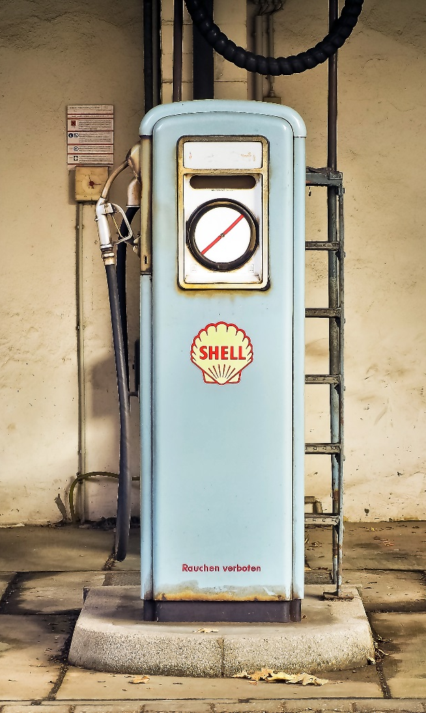
OPENING CONFERENCE
What about Fuel?
Retail over the road (OTR)
Cash, credit card, both
By driver or vehicle
Local OTR on account
In bulk (secured or not)
Tank capacity
Withdrawal logs
Purchase invoices
Inventory reconciliations

Slide 35

OPENING CONFERENCE
What documents are retained?
Do they have the required information (P550)?
Is the data summarized and if so, how (P560)?
Are the summaries used when reporting?

Slide 36
OPENING CONFERENCE
What about the fleet’s MPG/KPL
Are any fluctuations addressed?
Are any unusually high or low?
Is there fuel without distance?
Significant distance but no fuel?

Slide 37

Success!!!
An effective and efficient audit plan that includes clear communication will result in a better understanding for all parties!

Slide 38
The Audit Process
Preliminary Review
Opening Conference
Internal Control Evaluation
Field Work/Sampling/Testing
Audit Report and Audit File
Closing Conference

Slide 39
Evaluation of Internal Controls
What do IFTA and IRP require?
IFTA (A320)
IRP (APM 502)

Slide 40

Internal Control Evaluation
Review & document
Preliminary evaluation
Tests of compliance
Strengths & Weaknesses

Slide 41
Poll Question: All accounting procedures are internal controls.
True
False

Slide 42
Internal Control Evaluation
Large company
vs
small company
Should the internal control structure and distance accounting systems differ?

Slide 43
Poll Question: Internal Controls impact the sampling process.
True
False

Slide 44

Internal Controls
What are the benefits to performing a thorough internal control evaluation?
How does the evaluation of internal controls impact your audit scope?

Slide 45
The Audit Process
Preliminary Review
Opening Conference
Internal Control Evaluation
Field Work/Sampling/Testing
Audit Report and Audit File
Closing Conference

Slide 46

Basic Fieldwork
Review the carrier’s processes
Verify all available records
Data entry (distance/fuel/MPG/KPL)
Run trips through your mileage software tools
Comparisons
Identify errors

Slide 47

Basic Fieldwork
Types of Errors:
Isolated
Occasional math errors
MS instead of MI
Projected
Routing issues
Significant clerical errors

Slide 48

Communication during fieldwork
Communication throughout the process is important
Keeping the carrier informed eliminates blindsides for both parties

Slide 49
The Audit Process
Preliminary Review
Opening Conference
Internal Control Evaluation
Field Work/Sampling/Testing
Audit Report and Audit File
Closing Conference

Slide 50
The Audit Process
Preliminary Review
Opening Conference
Internal Control Evaluation
Field Work/Sampling/Testing
Audit Report and Audit File
Closing Conference

Slide 51
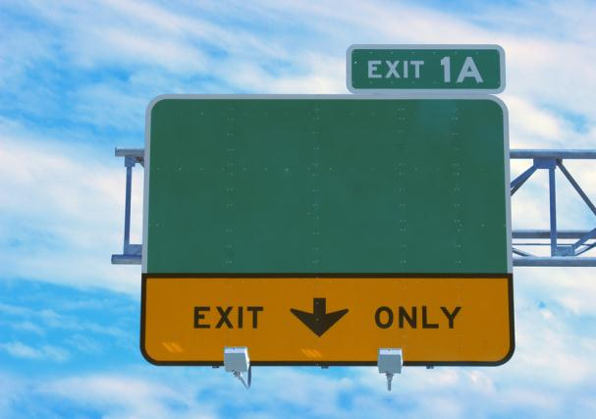
Closing/Exit Conference
What is required?
IFTA A450
IRP APM 404
Provide information
Avoid misunderstandings
Can have both a closing and exit conference

Slide 52

Closing/Exit Conference
What can you do to ensure your conference is effective and successful?
Prepare
Plan
Communicate

Slide 53


Questions

Slide 54
Links to Resources Available to Auditors
www.iftach.org
www.irponline.org
Best Practices Guides
Materials from past IFTA-IRP Audit Workshops

Slide 55

IFTA / IRP Auditing 101
kelly.heaton@ardot.gov
(501) 569-4994
mvandyke@dmv.nv.gov
(702) 486-5563

